Slide 1
CONTEXT- FREE LANGUAGES AND SIMPLIFICATION OF CONTEXT-FREE GRAMMAR

Slide 2
Context Free Grammar
Context free grammar is a formal grammar which is used to generate all possible strings in a given formal language.
Context free grammar G can be defined by four tuples as:
G= (V, T, P, S)

Slide 3
N is a set of non-terminal symbols.
T is a set of terminals where N ∩ T = NULL.
P is a set of rules, P: N → (N ∪ T)*, i.e., the left-hand side of the production rule P does have any right context or left context.
S is the start symbol.

Slide 4
Example
The grammar ({A}, {a, b, c}, P, A),
P : A → aA, A → abc.
The grammar ({S, a, b}, {a, b}, P, S),
P: S → aSa, S → bSb, S → ε
The grammar ({S, F}, {0, 1}, P, S),
P: S → 00S | 11F, F → 00F | ε

Slide 5

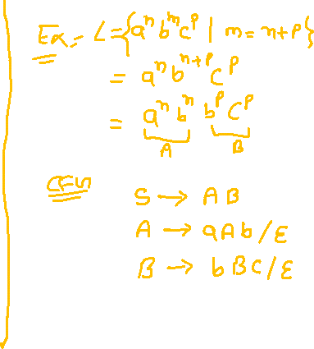
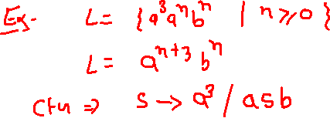
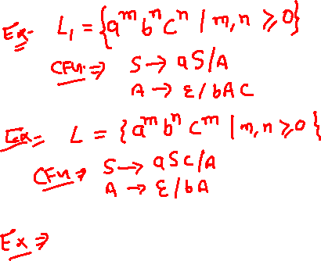
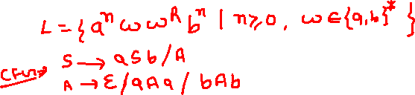

Slide 6
Capabilities of CFG
Context free grammar is useful to describe most of the programming languages.
If the grammar is properly designed then an efficient parser can be constructed automatically.
Using the features of associatively & precedence information, suitable grammars for expressions can be constructed.
Context free grammar is capable of describing nested structures like: balanced parentheses, matching begin-end, corresponding if-then-else's & so on.

Slide 7
Applications of CFG
Context Free Grammar (CFG) is of great practical importance. It is used for following purposes-
For defining programming languages
For parsing the program by constructing syntax tree
For translation of programming languages
For describing arithmetic expressions
For construction of compilers

Slide 8
Derivation
Derivation is a sequence of production rules. It is used to get the input string through these production rules.
During parsing we have to take two decisions.
These are as follows:
We have to decide the non-terminal which is to be replaced.
We have to decide the production rule by which the non-terminal will be replaced.
We have two options to decide which non-terminal to be replaced with production rule.

Slide 9
Left-most Derivation
In the left most derivation, the input is scanned and replaced with the production rule from left to right.
So in left most derivatives we read the input string from left to right.

Slide 10
Example
Production rules:
S = S + S
S = S - S
S = a | b |c
Input:
a - b + c

Slide 11
The left-most derivation is:
S = S + S
S = S - S + S
S = a - S + S
S = a - b + S
S = a - b + c

Slide 12
Right-most Derivation
In the right most derivation, the input is scanned and replaced with the production rule from right to left.
So in right most derivatives we read the input string from right to left.

Slide 13
Example
Production rules:
S = S + S
S = S - S
S = a | b |c
Input:
a - b + c

Slide 14
The right-most derivation is:
S = S - S
S = S - S + S
S = S - S + c
S = S - b + c
S = a - b + c

Slide 15
Parse Tree
Parse tree is the graphical representation of symbol. The symbol can be terminal or non-terminal.
In parsing, the string is derived using the start symbol. The root of the parse tree is that start symbol.
It is the graphical representation of symbol that can be terminals or non-terminals.

Slide 16
Parse tree follows the precedence of operators.
The deepest sub-tree traversed first.
So, the operator in the parent node has less precedence over the operator in the sub-tree.

Slide 17
The parse tree follows these points:
All leaf nodes have to be terminals.
All interior nodes have to be non-terminals.
In-order traversal gives original input string.

Slide 18
Example
Production rules:
S= S + S | S * S
S = a|b|c
Input:
a * b + c

Slide 19
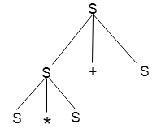
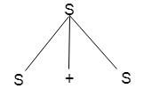
Step 1
Step 2

Slide 20
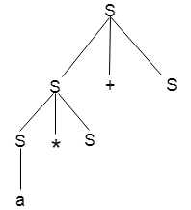
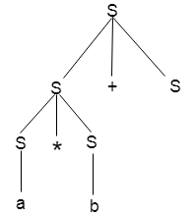
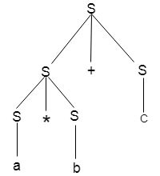
Step 3
Step 4
Step 5

Slide 21
POLLING QUESTIONS
Which of the following statement is false?
a) Context free language is the subset of context sensitive language
b) Regular language is the subset of context sensitive language
c) Recursively ennumerable language is the super set of regular language
d) Context sensitive language is a subset of context free language
Notes:
d

Slide 22
Example:
Design a CFG for the regular language corresponding to the RE 00 ∗11 ∗ .
The language is the concatenation of two languages: all strings of zeroes with all strings of ones.
P{S → CD C → 0C | 0 D → 1D | 1}

Slide 23
2. Which of the following statement is correct?
a) All Regular grammar are context free but not vice versa
b) All context free grammar are regular grammar but not vice versa
c) Regular grammar and context free grammar are the same entity
d) None of the mentioned
Notes:
a

Slide 24
Significance of CFG
Context free languages strike a balance between what is easy enough for a computer to understand and what is expressive enough for a human to use.
Mathematical expressions as well as large chunks of human languages can be modeled by context free grammars.
Therefore they are the basis of most programming languages and human-readable data formats.

Slide 25
Ambiguity in CFG
A grammar is said to be ambiguous if there exists more than one leftmost derivation or more than one rightmost derivative or more than one parse tree for the given input string.
If the grammar is not ambiguous then it is called unambiguous.

Slide 26
If a context free grammar G has more than one derivation tree for some string w ∈ L(G), it is called an ambiguous grammar.
There exist multiple right-most or left-most derivations for some string generated from that grammar.

Slide 27
Example 1
Problem: Check whether the grammar G with production rules −
X → X+X | X*X |X| a
is ambiguous or not.

Slide 28
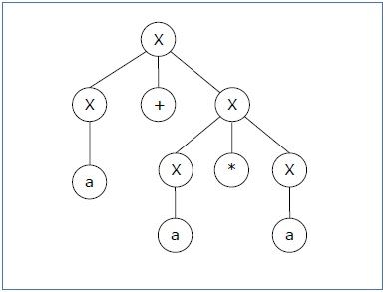
Solution
Let’s find out the derivation tree for the string "a+a*a". It has two leftmost derivations.
Derivation 1 −
X → X+X → a +X → a+ X*X → a+a*X → a+a*a
Parse Tree 1 −

Slide 29
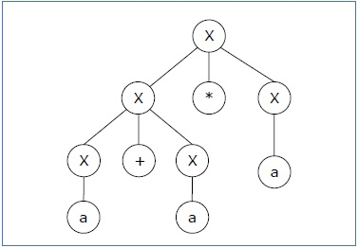
Since there are two parse trees for a single string "a+a*a", the grammar G is ambiguous.
Derivation 2 −
X → X*X → X+X*X → a+ X*X → a+a*X → a+a*a
Parse Tree 2 −

Slide 30
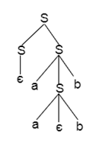
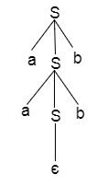
Example 2
P: S = aSb | SS |∈
For the string aabb, the above grammar generates two parse trees:

Slide 31
Practice Questions
1. Check whether the given grammar is ambiguous or not-
S → SS| a| b
2. Check whether the given grammar is ambiguous or not-
S → A / B, A → aAb / ab, B → abB / ∈
3. Check whether the given grammar is ambiguous or not-
S → AB / C, A → aAb / ab, B → cBd / cd, C → aCd / aDd, D → bDc / bc

Slide 32
4. Check whether the given grammar is ambiguous or not-
R → R + R / R . R / R* / a / b
5. Check whether the given grammar is ambiguous or not-
S → aSbS / bSaS / ∈

Slide 33
Closure Properties of CFL
CFL’s are closed under
Union
Concatenation
Kleene closure
Reversal
Homomorphisms
inverse homomorphisms
But not under intersection, complement or difference.

Slide 34
Union
Let L₁ and L₂ be two context free languages. Then L₁ ∪ L₂ is also context free.
Example
Let L₁ = { a^{n}b^{n} , n > 0}. Corresponding grammar G₁ will have P: S1 → aAb|ab
Let L₂ = { c^{m}d^{m} , m ≥ 0}. Corresponding grammar G₂ will have P: S2 → cBb| ε
Union of L₁ and L₂, L = L₁ ∪ L₂ = { a^{n}b^{n} } ∪ { c^{m}d^{m} }
The corresponding grammar G will have the additional production S → S1 | S2

Slide 35
Concatenation
If L₁ and L₂ are context free languages, then L₁L₂ is also context free.
Example
Union of the languages L₁ and L₂,
L = L₁L₂ = { a^{n}b^{n}c^{m}d^{m} }
The corresponding grammar G will have the additional production S → S1 S2

Slide 36
Kleene Star
If L is a context free language, then L* is also context free.
Example
Let L = { a^{n}b^{n} , n ≥ 0}. Corresponding grammar G will have P: S → aAb| ε
Kleene Star L₁ = { a^{n}b^{n} }*
The corresponding grammar G₁ will have additional productions S1 → S S1 | ε

Slide 37
Context-free languages are not closed under −
Intersection − If L1 and L2 are context free languages, then L1 ∩ L2 is not necessarily context free.
Intersection with Regular Language − If L1 is a regular language and L2 is a context free language, then L1 ∩ L2 is a context free language.
Complement − If L1 is a context free language, then L1’ may not be context free.

Slide 38
Decision Properties of CFL
Decision Algorithms are used to determine the following properties of a CFL.
Emptiness
Finiteness
Membership.

Slide 39
Decision Properties of CFL
Emptiness
For context Free grammar G, find if L(G) = φ.
Algorithm:
1.Remove useless variables
2.Check if start variable S is useless.

Slide 40
Decision Properties of CFL
Finiteness
For context Free grammar G, find if L(G) is finite.
Algorithm:
Remove useless symbols.
Remove unit and Ɛ productions.
Create dependency graph for variables.
If there is a loop in the dependency graph then the language is infinite.

Slide 41
Decision Properties of CFL
Membership
For context Free grammar G, find if w ∈ L(G).
Algorithm:
Exhaustive search parser
CYK parsing algorithm

Slide 42
CFG Simplification
In a CFG, it may happen that all the production rules and symbols are not needed for the derivation of strings.
Besides, there may be some null productions and unit productions.
Elimination of these productions and symbols is called simplification of CFGs.

Slide 43
Simplification essentially comprises of the following steps −
Reduction of CFG
Removal of Unit Productions
Removal of Null Productions

Slide 44
POLLING QUESTIONS
Context free language are closed under
A. union, intersection
B. union, kleene closure
C. intersection, complement
D. complement, kleene closure
Notes:
b

Slide 45
2. If G = ({S}, {a}, {S -> SS), S),
then language generated by G is
A.L (G) = φ
B.L(G) = a^{n}
C.L (G) = a*
D.L (G) = a^{n}ba^{n}
Notes:
a

Slide 46
3. A given grammar is called ambiguous if
A. two or more productions have the same non-terminal on the left hand side
B. a derivation tree has more than one associated sentence
C. there is a sentence with more than one derivation tree corresponding to it
D. brackets are not present in the grammar
Notes:
c

Slide 47
4. Which of the following derivations does a top-down parser use while parsing an input string? The input is assumed to be scanned in left to right order
(A) Leftmost derivation
(B) Leftmost derivation traced out in reverse
(C) Rightmost derivation
(D) Rightmost derivation traced out in reverse
Notes:
a

Slide 48
5. Which among the following is the root of the parse tree?
(A) Production P
(B) Nonterminal V
(C) Terminal T
(D) Starting symbol S
Notes:
d

